Slide 1


Fastest way of finding if a number is a Power of 2
Ankur M. Satle
https://ankursatle.wordpress.com | in /ankursatle
ankursatle@gmail.com | tw @ankursatle

Slide 2

A Lightning Talk from yesterday!

Slide 3
No!
This problem does not need a hash_map
☺ ☺ ☺

Slide 4
Find out if a given unsigned is a power of 2
Problem Statement

Slide 5
There are 10 kinds of people…
Those that understand numbers
And those that don’t…

Slide 6
Powers of 2?
Power of 2 | Value
2⁰⁰ | 1
2⁰¹ | 2
2⁰² | 4
2⁰³ | 8
2⁰⁴ | 16
2⁰⁵ | 32
2⁰⁶ | 64
2⁰⁷ | 128
2⁰⁸ | 256
2⁰⁹ | 512
2¹⁰ | 1024
2¹¹ | 2048
Power of 2 | Value, base 2
2⁰⁰ | 0b000000000001
2⁰¹ | 0b000000000010
2⁰² | 0b000000000100
2⁰³ | 0b000000001000
2⁰⁴ | 0b000000010000
2⁰⁵ | 0b000000100000
2⁰⁶ | 0b000001000000
2⁰⁷ | 0b000010000000
2⁰⁸ | 0b000100000000
2⁰⁹ | 0b001000000000
2¹⁰ | 0b010000000000
2¹¹ | 0b100000000000

Slide 7
Count bits
constexpr bool is_pow2_bit_counting_loop(unsigned n) {
int no_bits = 0;
for (auto i = 0u; i < sizeof(n); ++i) {
if ((n & (1u << i)) != 0u) ++no_bits;
}
return no_bits == 1;
}

Slide 8
Count bits - generic
#include <concepts>
constexpr bool is_pow2_bit_counting_loop(std::unsigned_integral auto n) {
int no_bits = 0;
for (auto i = 0u; i < sizeof(decltype(n)); ++i) {
if ((n & (1u << i)) != 0u) ++no_bits;
}
return no_bits == 1;
}

Slide 9
Match with powers of 2
constexpr bool is_pow2_match_with_powers(std::unsigned_integral auto n) {
for (auto i = 0u; i < sizeof(decltype(n)); ++i) {
if (n == (1u << i)) return true;
}
return false;
}

Slide 10
Kernighan & Ritchie from C Programming Language
constexpr bool is_pow2_knr(std::unsigned_integral auto n) {
return (n & (n - 1)) == 0;
}
4 → 0b0100 & 0b0011 = 0
5 → 0b0101 & 0b0100 = 0b0100
10 → 0b1011 & 0b1010 = 0b1010

Slide 11
constexpr bool is_pow2_knr(std::unsigned_integral auto n) {
return (n & (n - 1)) == 0;
}

Slide 12
Bitset
#include <bitset>
constexpr bool is_pow2_bitset(std::unsigned_integral auto n) {
std::bitset<sizeof(decltype(n))> bs(n);
return bs.count() == 1; //NOT constexpr! :(
}

Slide 13
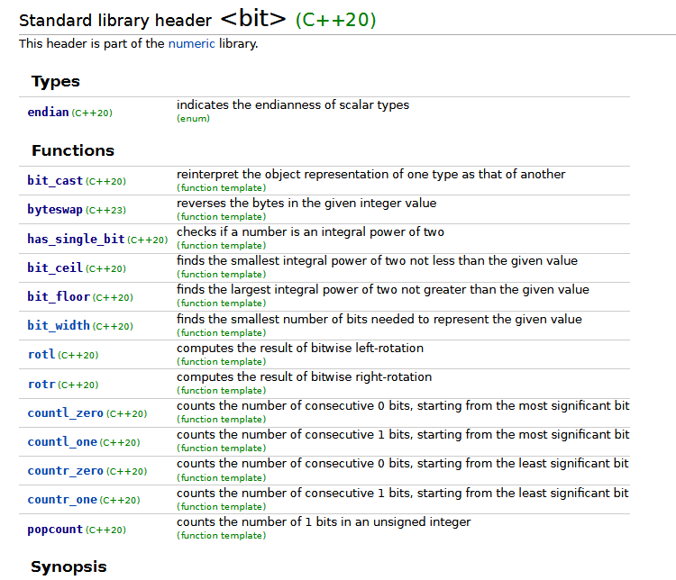

Slide 14
Popcount
#include <bit>
constexpr bool is_pow2_popcount(std::unsigned_integral auto n) {
return std::popcount(n) == 1;
}

Slide 15
has_single_bit
#include <bit>
constexpr bool is_pow2_has_single_bit(std::unsigned_integral auto n) {
return std::has_single_bit(n);
}

Slide 16
Performance!? popcount is just one instruction

Slide 17
Which of the 10 kinds are you?
Thank you!
Ankur M. Satle

